Slide 1
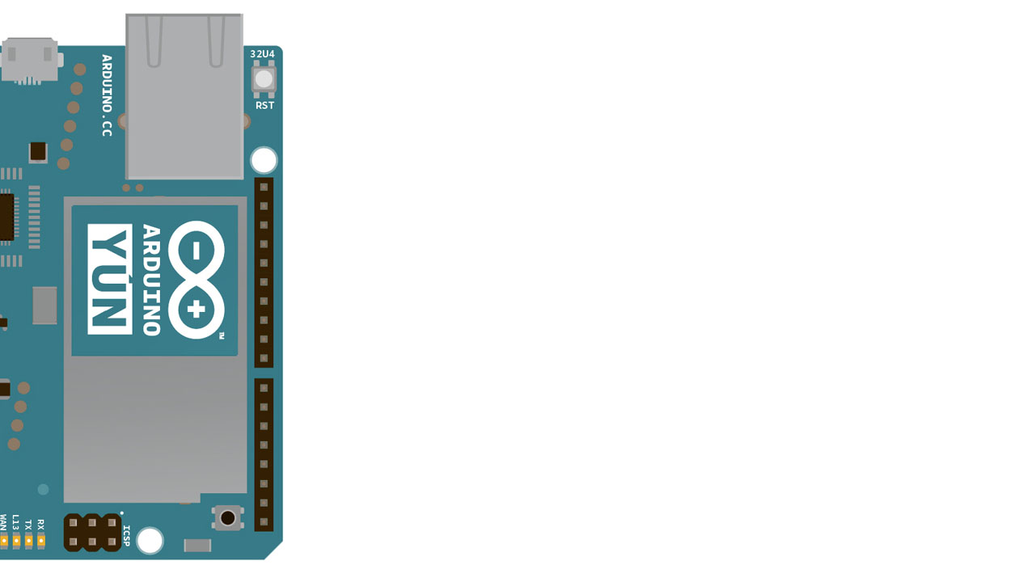
Automated Domestic Water Supply Control System
Group Number 04

Slide 2
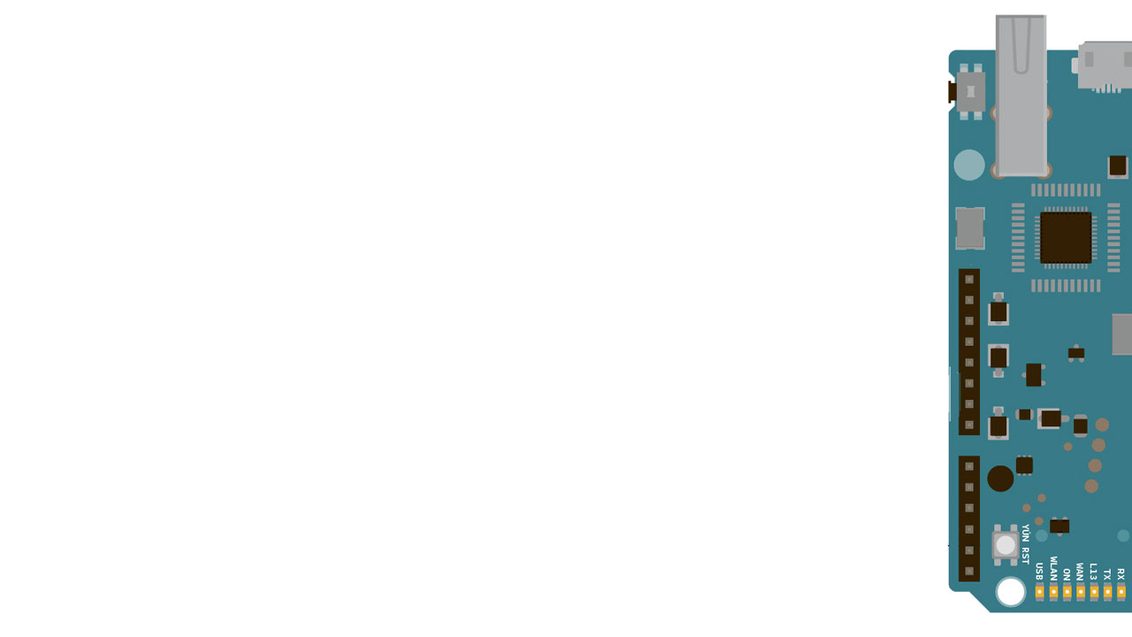
Content
Introduction
Sketch of the System
Functional Requirements
Non-Functional Requirements
User Roles
Hardware Requirements
Software Requirements
Methodology
Layout of the Android app
Project Plan

Slide 3
Introduction
An alternative for manual Domestic Water Supply System
Easier to use
Able to monitor current status of the system
Displays the History of water consumption

Slide 4
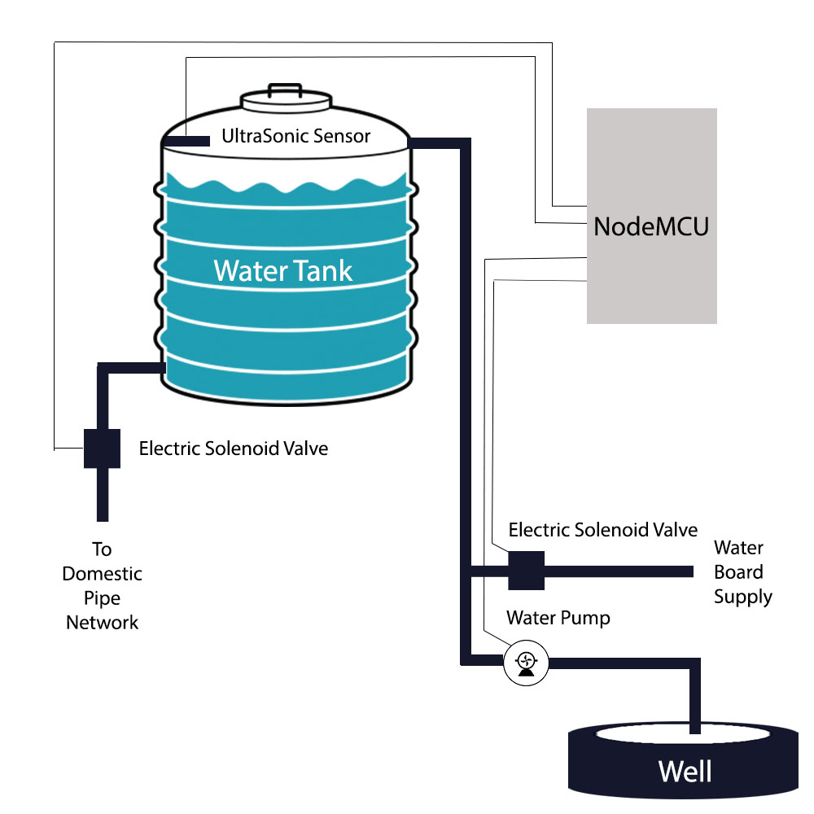
Sketch of the System

Slide 5
Functional Requirements
Take the information about the water tank and its dimensions from the user
Take user preference about source and water level range
Allow the user to turn on/off the Out Valve of the water tank.
The Mobile app should display the current status of the system.
As the user’s choice the system should automatically refill the tank when needed.

Slide 6
Non-Functional Requirements
User should be able to connect to the system.
The system should be accessible from anywhere within the house.
Average water filling speed calculation of water pump and Water Board supply should be accurate.
When the user stops filling the tank, system should respond immediately.
It should not allow unauthorized parties to access the system.
The mobile app interfaces should be well organized and understandable.

Slide 7
User Roles
The user can control the system by his/her smart phone.
The user can insert the dimensions of the water tank and setting the low level and the high level of the water tank.
The user can turn on/off the National Water Board supply, water pump of the well, water out valve via mobile app.
The user can allow the system to maintain the water level by itself as user choice.

Slide 8
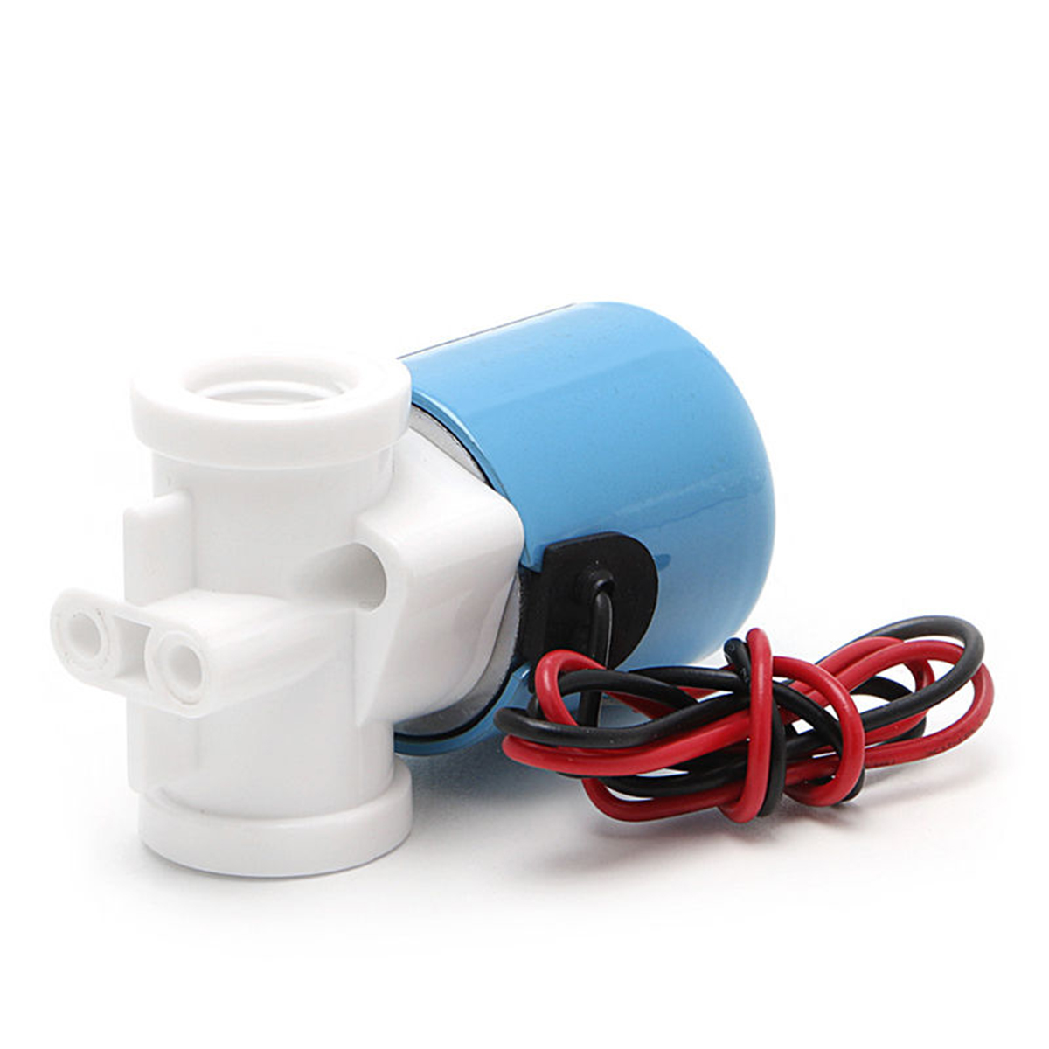
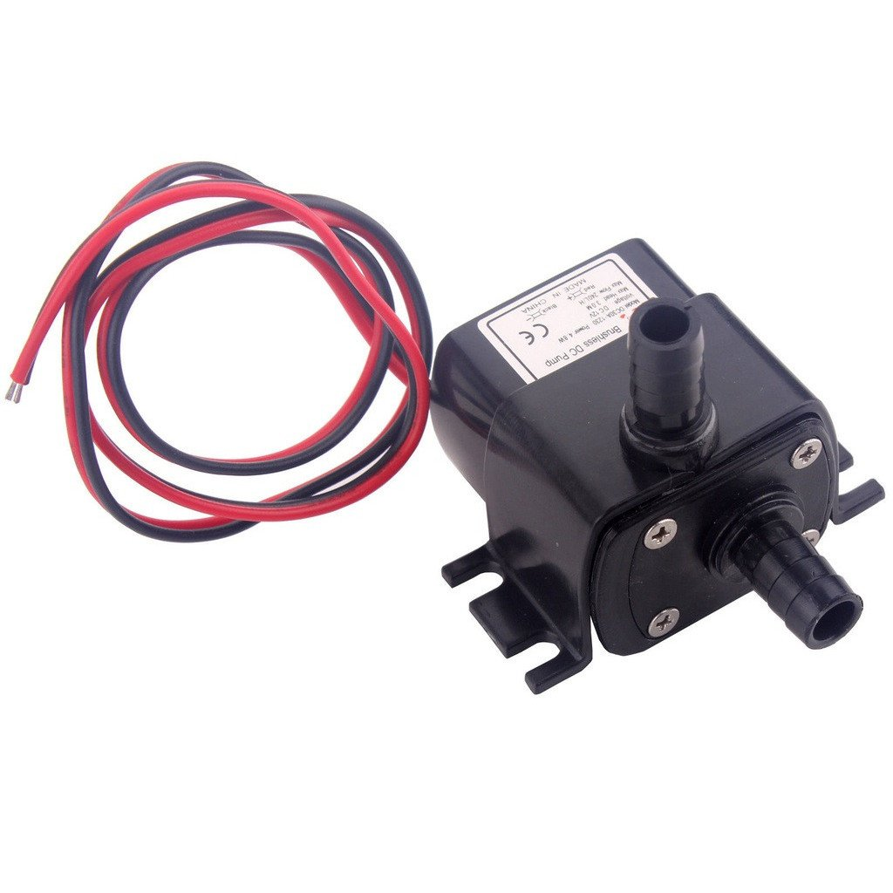
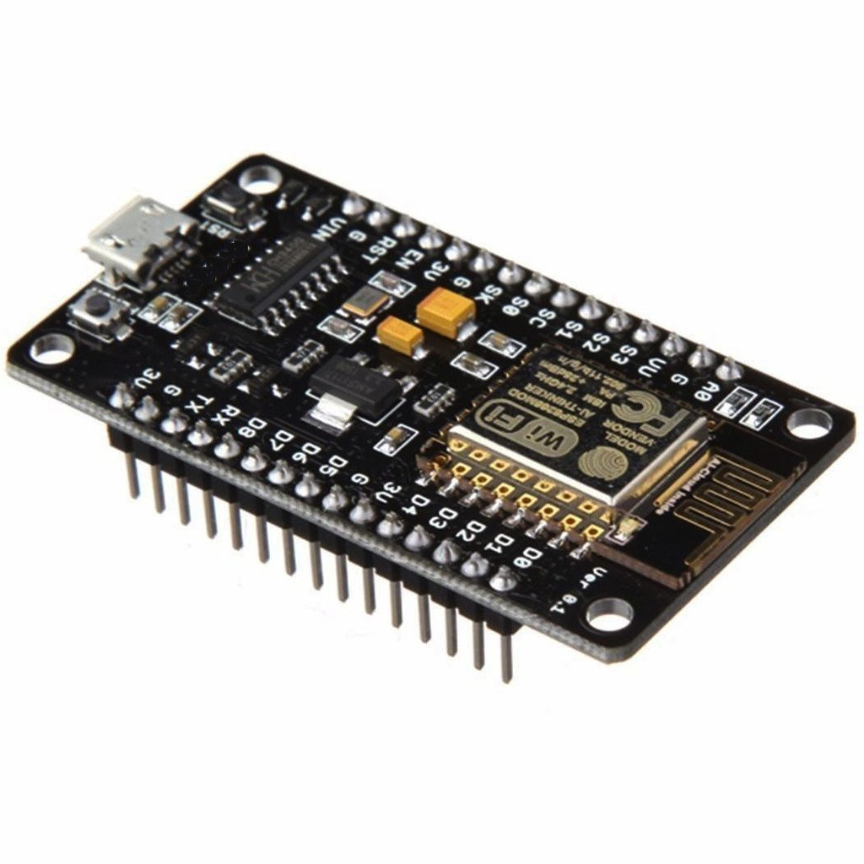
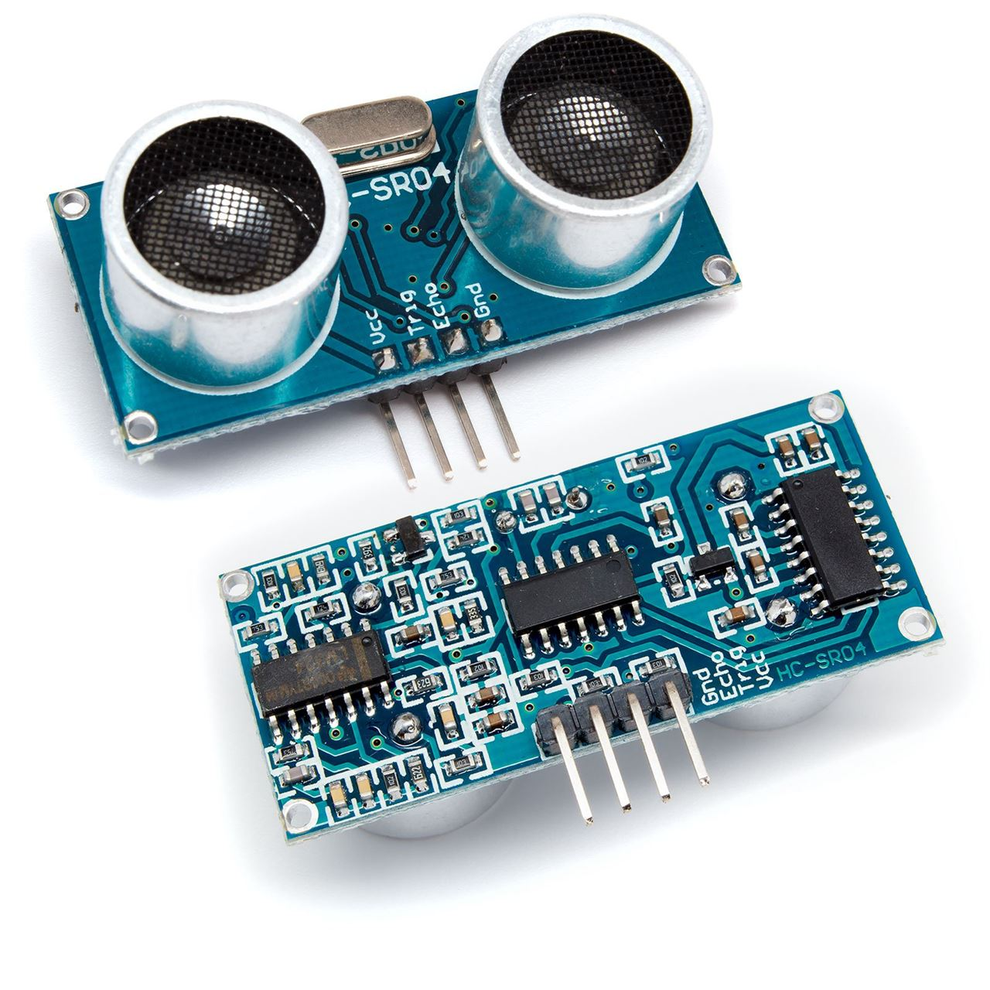
Hardware Requirements
For prototype the domestic water supply system
Water Containers
Pipe network
Mini Electric Solenoid Valve
Mini Water Pump
For building the Automated system
Node MCU
Ultrasonic sensor
Jumper Wires
Project Board

Slide 9


Software Requirements
Android Studio
Arduino IDE

Slide 10
Methodology
Development divided into 2 main parts.
Hardware system.
Build the Prototype of the water supply system
We don’t have to use relay modules because we use low voltages power sources for pumps and valves.
Android mobile app.
We planned to use waterfall model to develop the mobile app.

Slide 11
Layout of the android app
Setup Stage (Only for the first time when initiating the system)
Take water tank type
Take Dimensions of the tank
Take Details about automated Controlling
Control
Automated Controlling
Manual Controlling
Information
Daily/ monthly water consumption
Average speed of water sources
Current State

Slide 12
Project plan
Stage | Duration
 | FEB |  | MARCH |  |  |  | APRIL |  |  |  | MAY
 | W1 | W2 | W3 | W4 | W5 | W6 | W7 | W8 | W9 | W10 | W11 | W12 | W13 | W14 | W15
Requirement Gathering and Defining the scope
Submit proposal and presentation
Requirements Analysis and Specification
System design
Interface (mobile app) design
Gathering Hardware Requirements
Development session 1 (build hardware prototype)
Interface (mobile app) implementation
Development session 2 (Functionality implementation)
Integration and testing
Scope review and improvements
Final testing
Documentation

Slide 13
Group Members
Registration Number | Name
UWU/CST/15/006 | Chandrapala A.G.N.C
UWU/CST/15/021 | Krishnagobal S.
UWU/CST/15/036 | Priyadarshana L.P.K.R
UWU/CST/15/053 | Weerathunge W.M.S. H.

Slide 14
Thank You

